Slide 1
Neural Ordinary Differential Equation with Gaussian Process
Jaehyoung Hong

Slide 2
Neural Ordinary Differential Equation

Slide 3
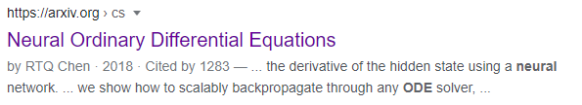
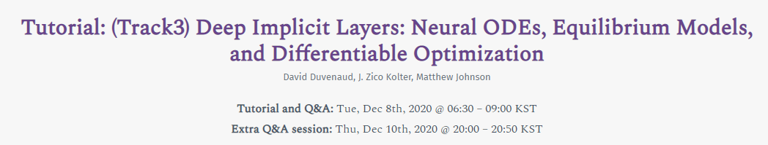
Neural Ordinary Differential equation (Neural ODE;NODE) got a lot of attention after 2018
Neurips2018 best paper
One of the tutorial in Neurips2020

Slide 4

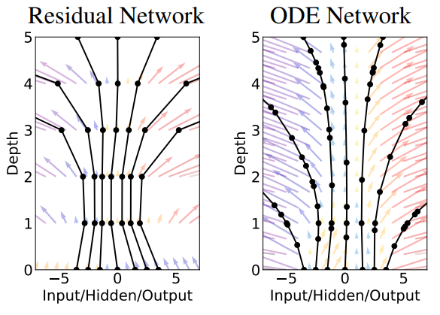










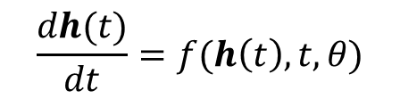

Neural ODE considers the flow of input through hidden units of Neural network as the discretization of ODE
Neural Network
Neural ODE
$$h_{5}$$
$$h_{4}$$
$$\frac{dh(t)}{dt}=f(h\left(t\right),t,θ)$$
$$h_{t+1}=h_{t}+f(h_{t},θ_{t})$$
$$h_{3}$$
$$h(t)$$
$h_{t}$: The output of $t$-th hidden layer
$$h_{2}$$
$θ_{t}$: The parameters (variables, weights) of $t$-th hidden layer
$$h_{1}$$
$$h_{0}$$

Slide 5
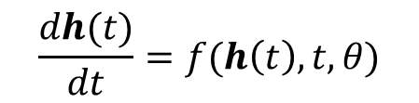

We can expect some pros and cons of Neural ODE
Neural ODE
Neural Network
vs
$$\frac{dh(t)}{dt}=f(h\left(t\right),t,θ)$$
$$h_{t+1}=h_{t}+f(h_{t},θ_{t})$$
Pros
Cons
- Memory efficiency: Less parameters
- Slow: Integration to solve ODE
- Continuous time-series model: Can handle irregular data
- Adaptive computation: Can achieve wanted accuracy

Slide 6
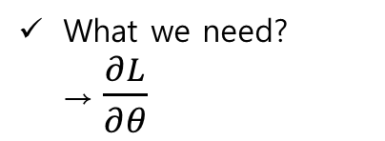
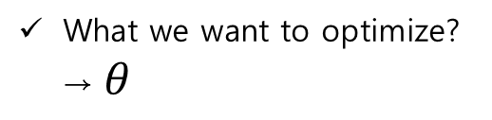

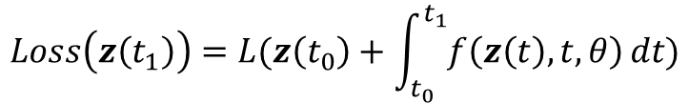
Reverse-mode automatic differentiation of ODE through Adjoint sensitivity method
Notation
Here, we use $z(t)$ rather than $h(t)$, consistent with the article
$z(t_{0})$ is input and $z(t_{1})$ is output
Loss function
What we want to optimize? → $θ$
$$Loss\left(z\left(t_{1}\right)\right)=L(z\left(t_{0}\right)+\int_{t_{0}}^{t_{1}}{f\left(z\left(t\right),t,θ\right)}dt)$$
What we need? →$\frac{∂L}{∂θ}$
$$=L(ODESolve\left(z\left(t_{0}\right),f,t_{0},t_{1},θ\right))$$

Slide 7



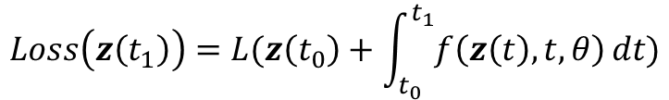


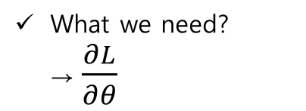

Reverse-mode automatic differentiation of ODE through Adjoint sensitivity method
Loss function
$$Loss\left(z\left(t_{1}\right)\right)=L(z\left(t_{0}\right)+\int_{t_{0}}^{t_{1}}{f\left(z\left(t\right),t,θ\right)}dt)$$
What we need? →$\frac{∂L}{∂θ}$
$$=L(ODESolve\left(z\left(t_{0}\right),f,t_{0},t_{1},θ\right))$$
Cannot directly implement backward calculation ($∵$ODEsolver)
Adjoint $a\left(t\right)=\frac{∂L}{∂z(t)}$
$a(t)$ can computed by ODEsolver
$$\frac{da(t)}{dt}=−a{\left(t\right)}^{T}\frac{∂f(z\left(t\right),t,θ)}{∂z}$$
Input is $\frac{∂L}{∂z(t_{1})}$

Slide 8
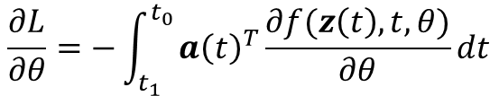
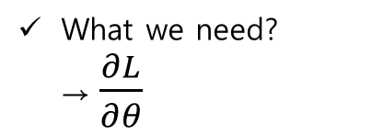
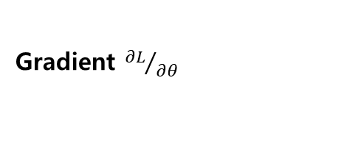
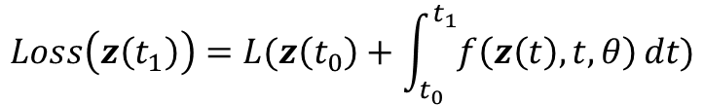


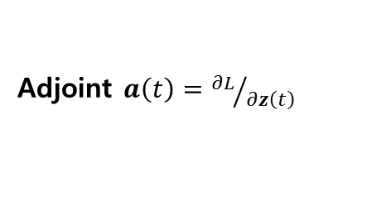

Reverse-mode automatic differentiation of ODE through Adjoint sensitivity method
Loss function
$$Loss\left(z\left(t_{1}\right)\right)=L(z\left(t_{0}\right)+\int_{t_{0}}^{t_{1}}{f\left(z\left(t\right),t,θ\right)}dt)$$
What we need? →$\frac{∂L}{∂θ}$
Adjoint $a\left(t\right)={∂L}/{∂z\left(t\right)}$
$$\frac{da(t)}{dt}=−a{\left(t\right)}^{T}\frac{∂f(z\left(t\right),t,θ)}{∂z}$$
$a(t)$ can computed by ODEsolver
Gradient ${∂L}/{∂θ}$
: Easily calculated by backpropagation
$$\frac{∂L}{∂θ}=−\int_{t_{1}}^{t_{0}}{a{\left(t\right)}^{T}\frac{∂f(z\left(t\right),t,θ)}{∂θ}dt}$$
$\frac{∂L}{∂θ}$ can computed by ODEsolver

Slide 9
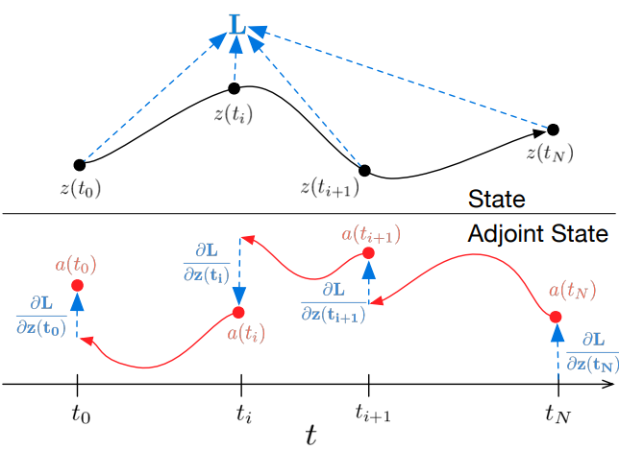
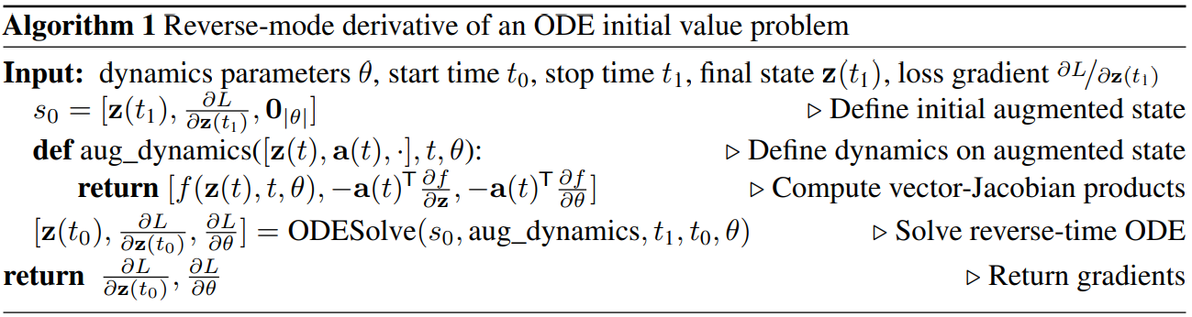
Reverse-mode automatic differentiation of ODE through Adjoint sensitivity method
ODEsolver can calculate the wanted value at multiple times
Thus Adjoint method can calculate gradient
if Loss is depending on multiple state

Slide 10



Proof of ODE of $a(t)$
Adjoint $a\left(t\right)=\frac{∂L}{∂z(t)}$
$$\frac{da(t)}{dt}=−a{\left(t\right)}^{T}\frac{∂f(z\left(t\right),t,θ)}{∂z}$$
Will prove with the black board

Slide 11
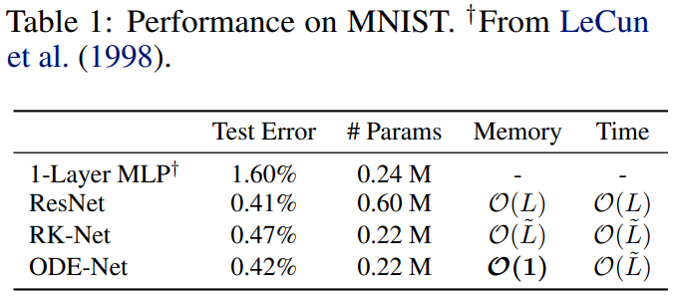
Neural ODE provides good result for supervised learning (MNIST) with reasonable memory
RK-Net: Directly backpropagate without adjoint method
ODE-Net: Implicit ODEsolver with adjoint method
$\tilde{L}$: Number of forward evaluation & $L$: Number of Layers

Slide 12
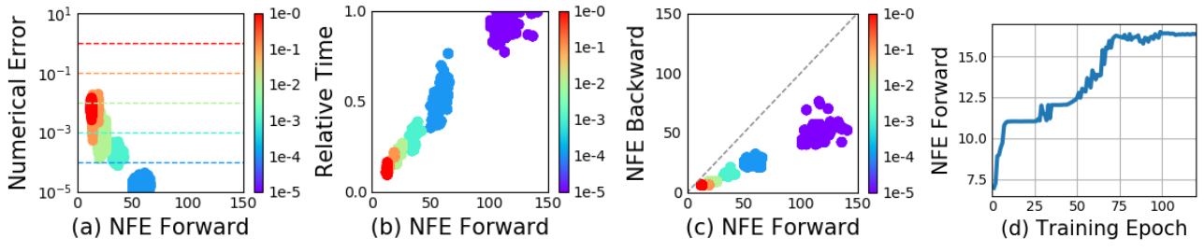
Neural ODE can control error
NFE=Number of Function Evaluation↑
NFE forward > NFE backward:
- Adjoint method is computationally efficient
Error↓
NFE forward increase throughout training
- Adapting to increasing complexity of the model?
Time (computational cost)↑
Accuracy-Cost trade-off

Slide 13
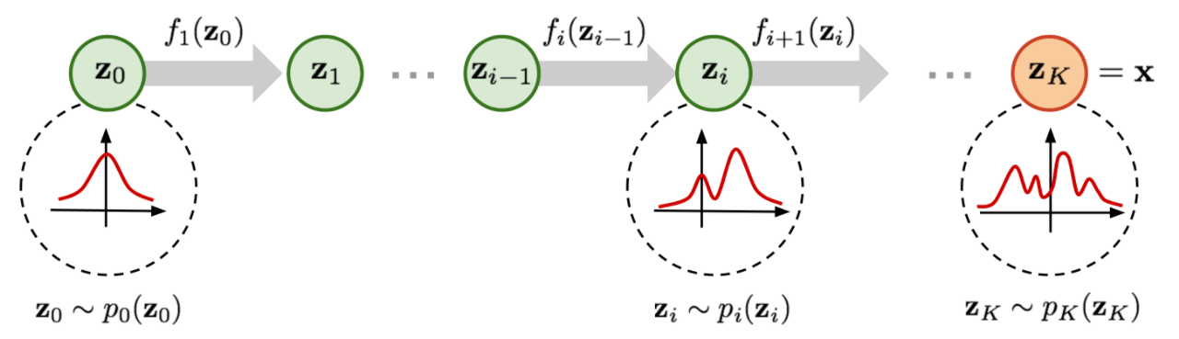
Normalizing flows change simple distribution to complex distribution by applying a sequence of invertible transformation functions
How to learn this kind of complex distribution?
Start from the simple distribution (usually $N(0,I)$;$z_{0}$)
Applying sequence of invertible transformation ($z_{i}=f(z_{i−1}$))

Slide 14
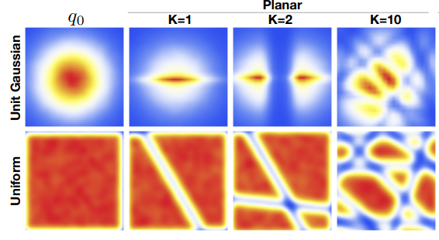
Normalizing flows (NF) can make complex distribution
Planar NF: $z\left(t+1\right)=z\left(t\right)+uh(w^{T}z\left(t\right)+b)$

Slide 15

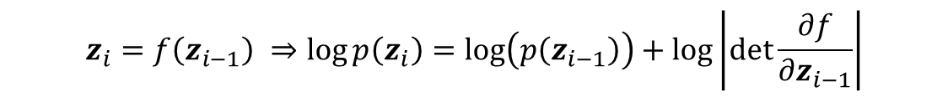

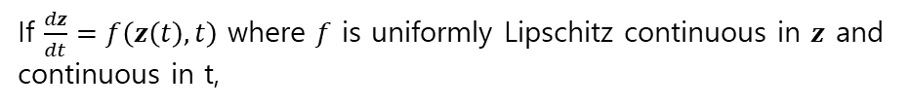
If we consider NF as continuous transformation computational cost reduced (Determinant→Trace)
Distribution after applying transformation
$$z_{i}=f\left(z_{i−1}\right) ⇒\log{p\left(z_{i}\right)=\log\left(p\left(z_{i−1}\right)\right)+\log\left|\det{\frac{∂f}{∂z_{i−1}}}\right|}$$
High cost $O(N^{3})$
Continuous transformation
If $\frac{dz}{dt}=f\left(z\left(t\right),t\right)$ where $f$ is uniformly Lipschitz continuous in $z$ and continuous in t,
$$\frac{∂\log{p(z\left(t\right))}}{∂t}=−tr(\frac{df}{dz(t)})$$
$p(z\left(t\right))$ can be obtained by ODEsolver
Taylor series + Derivative of determinant is can be represented by trace of adjoint

Slide 16
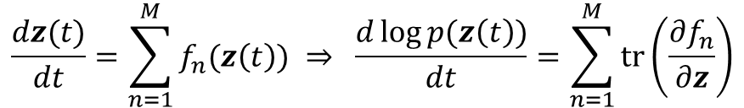

Since trace is linear, Neural ODE can handle flow models having many hidden units
Multiple hidden units with linear cost
$$\frac{dz(t)}{dt}=\sum_{n=1}^{M}{f_{n}(z\left(t\right))} ⇒ \frac{d\log{p(z\left(t\right))}}{dt}=\sum_{n=1}^{M}{tr\left(\frac{∂f_{n}}{∂z}\right)}$$
$M$: the number of hidden units (width)
Continuous NF (CNF)
$$\frac{dz}{dt}=\sum_{n}{σ_{n}\left(t\right)f_{n}(z)}$$
$σ_{n}\left(t\right)∈(0,1)$: Neural network; when $f_{n}$ affect NF

Slide 17
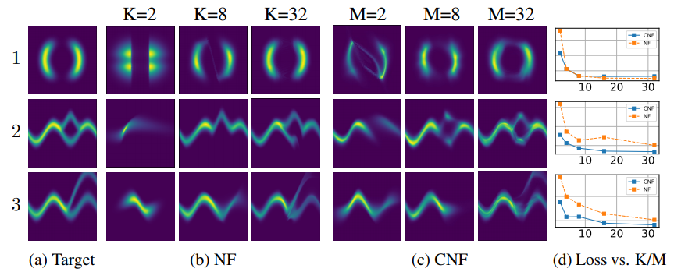
CNF usually learns target distribution better than NF
Training loss = $KL(q(x)||p\left(x\right))$ where $q(x)$: Distribution made by NF (CNF) and $p(x)$: target distribution
K = Number of Layers in NF
M = Number of units in CNF

Slide 18
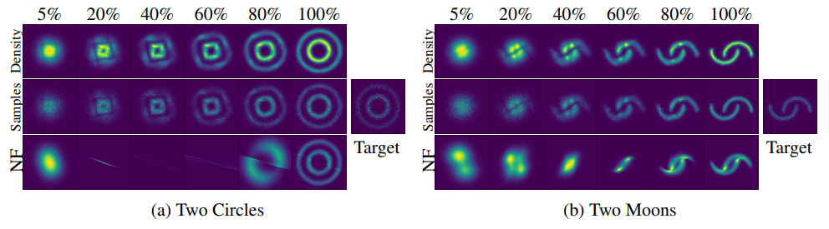
CNF learns target distribution with smoother and more expressive way
Training loss = $E_{p\left(x\right)}[\log{q(x)}]$: 5,20,40,…,100% figures obtained by reversing NF or CNF
CNF

Slide 19
Improving Robustness and Uncertainty Modelling in Neural Ordinary Differential Equations

Slide 20
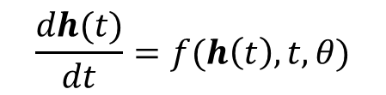
There have been proposed some approaches to improve accuracy of Neural ODE
$$\frac{dh(t)}{dt}=f(h\left(t\right),t,θ)$$
Accuracy is worse than Neural net
Approach 1. Using SDE (Neural SDE): Too difficult so that architecture is limited
Approach 2. Concatenation of Neural ODE blocks: Similar accuracy to Neural net
Thicker Neural net
Remaining problem:
Robustness: Bad for unobserved data or Noise
Uncertainty modeling: How can we believe the result
Gaussian process (GP)

Slide 21
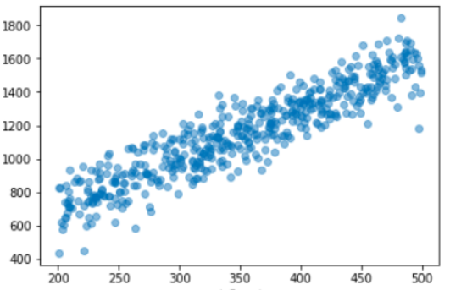
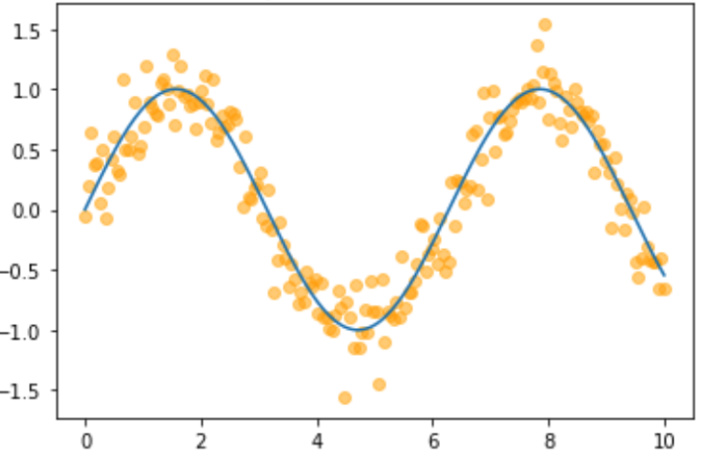


GP is non-parametric model which do not need assumption for model architecture
Parametric model: You need to “see” the data to determine accurate model
$$y=β_{1}x+β_{0}$$
$$y=β_{2}x^{2}+β_{1}x+β_{0}$$
Data complexity↑ then Number of parameter↑
GP reflects complexity of data itself
You need to decide complexity of model
How about ${10}^{5}$ dimensional data?

Slide 22
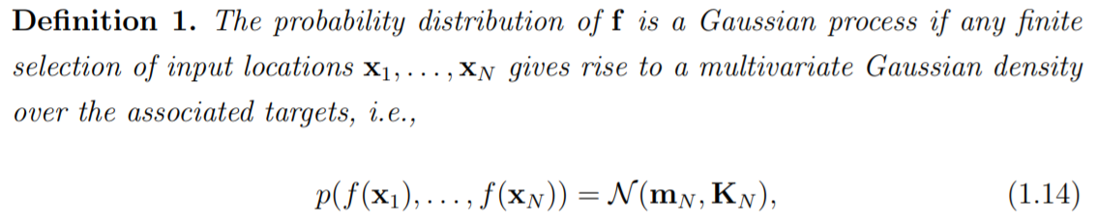
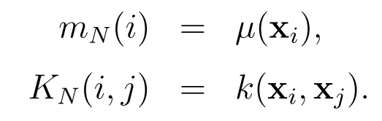
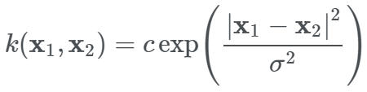
Gaussian Process is one of the popular non-parametric model describing distribution of function
Confidence interval → Uncertainty

Slide 23
Prediction using Gaussian process regression
Given N-inputs $X=\left\{x_{1},…x_{N}\right\}, y=\{y_{1},…,y_{N}\}$
$P\left(f | X,θ\right)=N\left(m_{N},K_{N}\right)=N(0,K_{N})$ : GP assumption
Prior
$P\left(y | f,X,θ\right)=N(f,σ_{n}^{2}I_{N})$ : $y=f\left(X\right)+ε$ where $ε\sim N\left(0,σ^{2}\right)$ noise assumption
Likelihood
$P\left(f | y,X,θ\right)=\frac{P\left(y | f,X,θ\right)×P\left(f | X,θ\right)}{Z(θ)}$ : Also Gaussian
Posterior
$Z\left(θ\right)=P\left(y | X,θ\right)=∫P\left(y | f,X,θ\right)×P\left(f | X,θ\right)df$ : Have explicit form
When M test set is given $X^{∗}$
$P\left(f^{∗} | y,X,X^{∗},θ\right)=∫P\left(f^{∗} | X,X^{∗},f,θ\right)P\left(f | y,X,θ\right)df$ : Also Gaussian and have explicit form

Slide 24
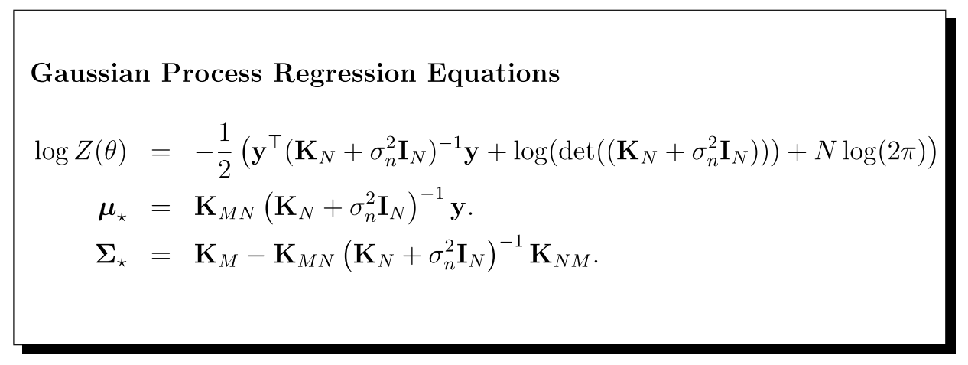
Prediction using Gaussian process regression

Slide 25
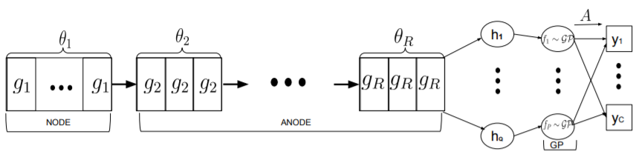

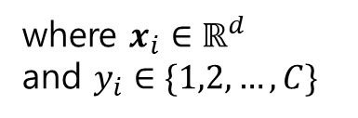


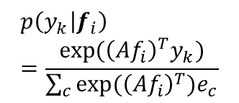



Combining Neural ODE with GP (NODE-GP)
Easiest way for combining neural net with GP is just use GP as “final layer”!!!
Given data
Latent variable
GP output
Class prob
$$D=\left\{X,y\right\}={\left\{\left(x_{i},y_{i}\right)\right\}}_{i=1}^{N}$$
Neural ODE blocks
GP
$$×A_{P×C}$$
where $x_{i}∈ℝ^{d}$
and $y_{i}∈\{1,2,…,C\}$
$$x_{i}→H_{i}=(h_{1},…,h_{Q})$$
$$h_{j}→f_{j}$$
$$p(y_{k}|f_{i})$$
d-dimensional data with labels (C classes)
Q-dimensional latent variables
P-output (Using only subsets of $H_{i})$
$f_{i}=(f_{1},…,f_{P})$
$$p\left(y_{k} | f_{i}\right)=\frac{exp⁡({\left(Af_{i}\right)}^{T}y_{k})}{\sum_{c}{exp⁡({\left(Af_{i}\right)}^{T})e_{c}}}$$

Slide 26




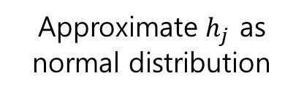
Using ELBO to calculate the likelihood
Likelihood
$$p\left(y_{k} | f_{i}\right)=\frac{exp⁡({\left(Af_{i}\right)}^{T}y_{k})}{\sum_{c}{exp⁡({\left(Af_{i}\right)}^{T})e_{c}}}$$
No more Gaussian
GP output
ELBO
Approximate $h_{j}$ as normal distribution
$$q\left(H\right)=\prod_{j}{N(h_{j}|μ_{j},S_{j})}$$
$$\log{p(y)}≥E_{q\left(H\right)p\left(f | H\right)}\left[\log{p\left(y | f\right)}\right]−KL[q(H)||p\left(H\right)]$$
$$h_{j}→f_{j}$$
P-output (Using only subsets of $H_{i})$

Slide 27
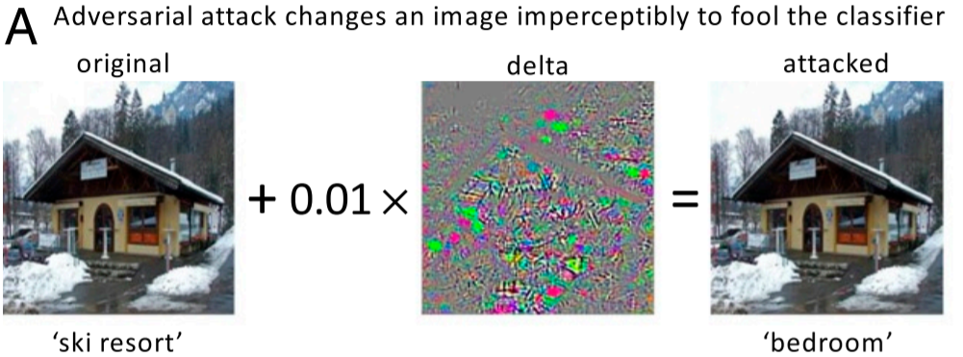
NODE-GP shows better accuracy for Adversarial attacks
Noise

Slide 28
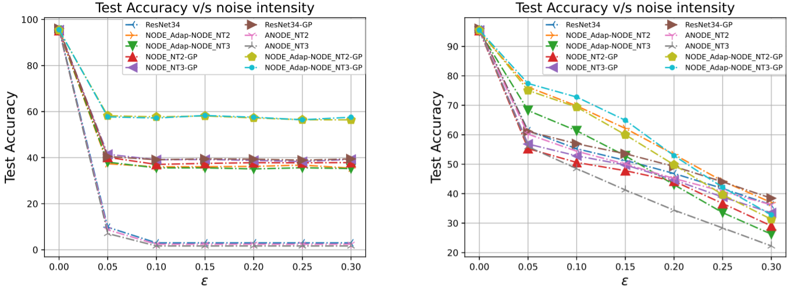

NODE-GP shows better accuracy for Adversarial attacks
NT2 and NT3: Step size of ODEsolver
$ε$: Noise severity

Slide 29
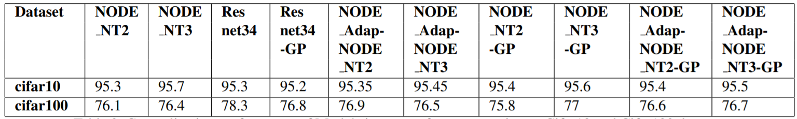
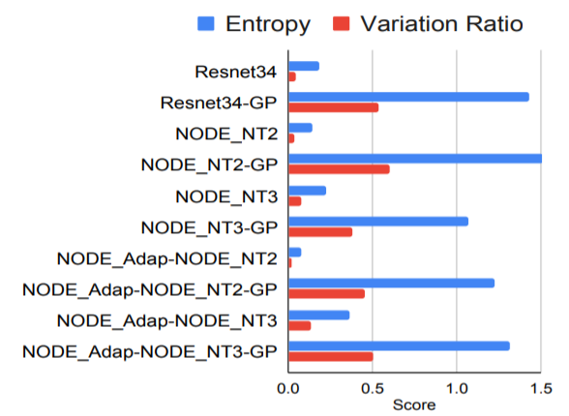
NODE-GP shows reasonable uncertainty for Out-of-Distribution data
Trained for cifar10 and test for cifar100
Accuracy is similar
Left measures are made to show large value if the test distribution is different from trained distribution
NODE-GP shows higher score which is reasonable

Slide 30
Conclusion
How “mathematics” can be applied to Neural network?
How “statistics” can be applied to Neural network?

